Slide 1
E. N. Tsyganov
Cold Fusion Power, International
OSNovation Systems, Inc., Santa Clara, CA
COLD NUCLEAR FUSION
6th International Conference “Charged & Neutral Particles Channeling
Phenomena - Channeling 2014” (Capri, Italy, October 5-10, 2014)

Slide 2
Cold Nuclear Fusion
E.N. TSYGANOV ¹, M.D. BAVIZHEV ², M.G. BURYAKOV ³,
S.B. DABAGOV ⁴, V.M. GOLOVATYUK ³, S.P. LOBASTOV ³
¹ Cold Nuclear Fusion, International
² LLC “Radiy”, Moscow
³ Joint Institute for Nuclear Research, Dubna
⁴ National Research Nuclear University “MEPhI”;
P.N. Lebedev Physical Institute of the Russian Academy of Sciences, Moscow
6th International Conference “Charged & Neutral Particles Channeling
Phenomena - Channeling 2014” (Capri, Italy, October 5-10, 2014)

Slide 3

Cold nuclear fusion. Look beyond the horizon ...
Flammarion, 1888, based on the 16th century vision
6th International Conference “Charged & Neutral Particles Channeling
Phenomena - Channeling 2014” (Capri, Italy, October 5-10, 2014)

Slide 4
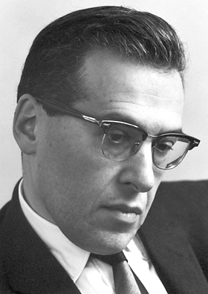
Julian Schwinger
Tried to “Look beyond the horizon …”
“The pressure for conformity is enormous. I have
experienced it in editors’ rejection of submitted papers, based on venomous criticism of anonymous referees. The replacement of impartial reviewing by censorship will be the death of science”.
Statement made while resigning from the American
Physical Society
6th International Conference “Charged & Neutral Particles Channeling
Phenomena - Channeling 2014” (Capri, Italy, October 5-10, 2014)

Slide 5

Richard Feynman
“Physics is the experimental science.”
6th International Conference “Charged & Neutral Particles Channeling
Phenomena - Channeling 2014” (Capri, Italy, October 5-10, 2014)

Slide 6
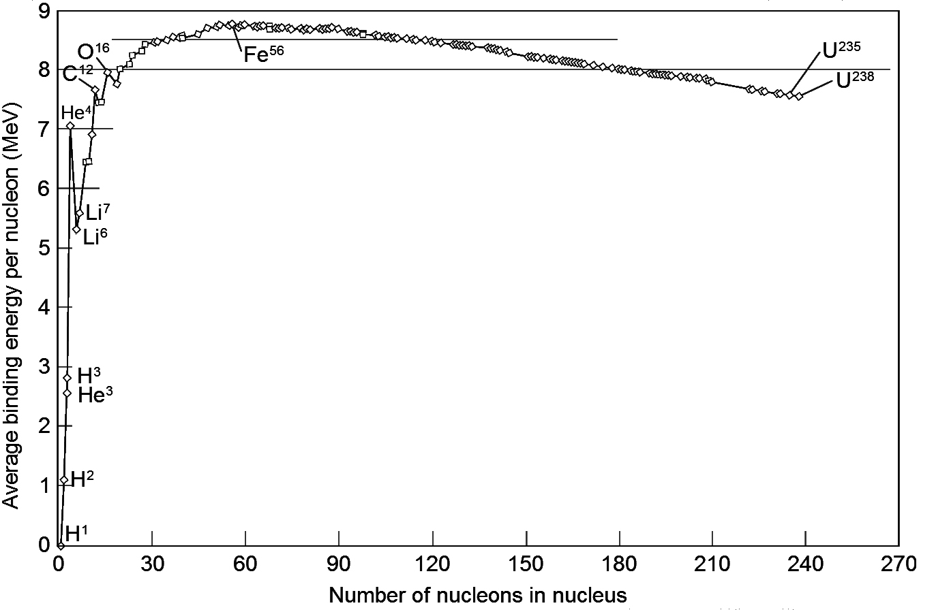
Binding energy
6th International Conference “Charged & Neutral Particles Channeling
Phenomena - Channeling 2014” (Capri, Italy, October 5-10, 2014)

Slide 7
Currently, humanity has come to a stage of development when the struggle for energy resources is becoming especially important. All known sources of energy together will not be able to provide for our demand in the near future. Chemical energy is additionally limited by the so-called greenhouse effect.
Nuclear energy that based on the use of fissile materials is not the long-term solution to the problem, because stocks of these materials are limited. In addition, the required safe preservation of the radioactive waste for about 10,000 years is a serious problem.
6th International Conference “Charged & Neutral Particles Channeling
Phenomena - Channeling 2014” (Capri, Italy, October 5-10, 2014)

Slide 8
Cross-section of fusion in the collision of two deuterium nuclei:
σ (E) = S (E) E⁻¹ exp(−2πη(E))
2πη = 31.41/E ^{½}
Here, the kinetic energy of the deuteron E is shown in the
center of mass in keV. S(E) — astrophysical factor at low
energies; it can be assumed to be constant. The main energy
dependence of the cold fusion cross-section is contained in the
expression exp(-2πη(E)), which determines the probability of penetration of the deuteron through the Coulomb barrier in a single collision. In the event of a collision of atoms, the energy E must be replaced by E_{eff} =E + U_{e}, where U_{e} = e²/R_{a}. For the unexcited hydrogen atom, U_{e} = 27 eV.
6th International Conference “Charged & Neutral Particles Channeling
Phenomena - Channeling 2014” (Capri, Italy, October 5-10, 2014)

Slide 9
Initial optimistic expectations of a transition to the controlled thermonuclear fusion process never materialized.
Technical difficulties of obtaining viable super-hot plasma and the damaging effects of the enormous neutron flux arising as a result of thermonuclear reactions are pushing this development to the more distant and uncertain future.
6th International Conference “Charged & Neutral Particles Channeling
Phenomena - Channeling 2014” (Capri, Italy, October 5-10, 2014)

Slide 10
The term “cold fusion” describes a number of processes at relatively low temperature, leading to the generation of heat due to the fusion of two nuclei.
Under normal conditions, such processes are prevented by the Coulomb barrier, which precludes the convergence of nuclei.
6th International Conference “Charged & Neutral Particles Channeling
Phenomena - Channeling 2014” (Capri, Italy, October 5-10, 2014)

Slide 11
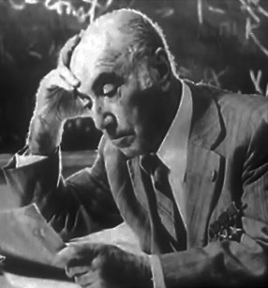
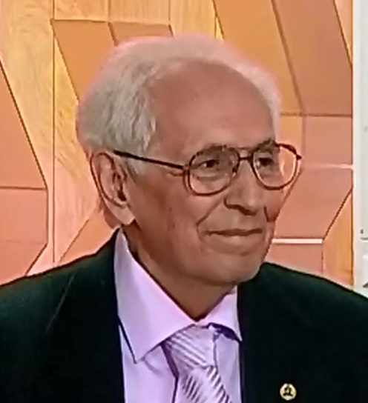
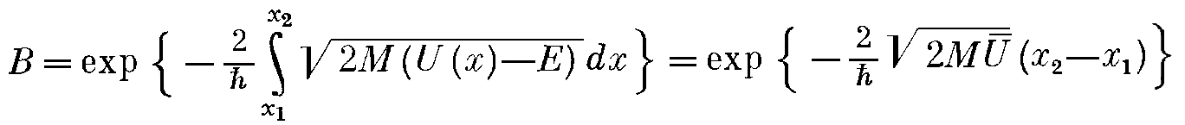
Zeldovich, Ya.B., Gerstein, S.S. (1960). U. F. N., LXXI(4), 1960, 581.
Consideration of piezo-fusion
Ya.B. Zeldovich
S.S. Gerstein
The pressure needed to achieve the effect of
piezo-fusion happens to be too high.
6th International Conference “Charged & Neutral Particles Channeling
Phenomena - Channeling 2014” (Capri, Italy, October 5-10, 2014)

Slide 12
About 25 years ago Fleischmann and Pons performed experiments that demonstrated the possibility of “cold” DD fusion when nuclear reagents are implanted in metallic crystals.
6th International Conference “Charged & Neutral Particles Channeling
Phenomena - Channeling 2014” (Capri, Italy, October 5-10, 2014)

Slide 13
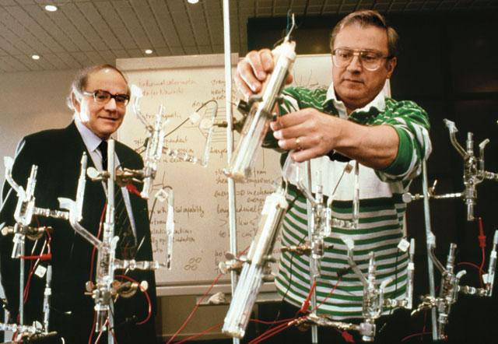
Martin Fleischmann and Stanley Pons, 1989
6th International Conference “Charged & Neutral Particles Channeling
Phenomena - Channeling 2014” (Capri, Italy, October 5-10, 2014)

Slide 14
Quickly rejected by most scholars as irreproducible and not having a consistent theoretical interpretation, these experiments, however, gradually began to give consistent results.
Classic examples are the experiments made by Dr. McKubre and his colleagues at the Stanford Research Institute, International. The results of these experiments demonstrated a reliable heat of nonchemical origin, whereby the effect exceeded about 100 experimental errors.
6th International Conference “Charged & Neutral Particles Channeling
Phenomena - Channeling 2014” (Capri, Italy, October 5-10, 2014)

Slide 15
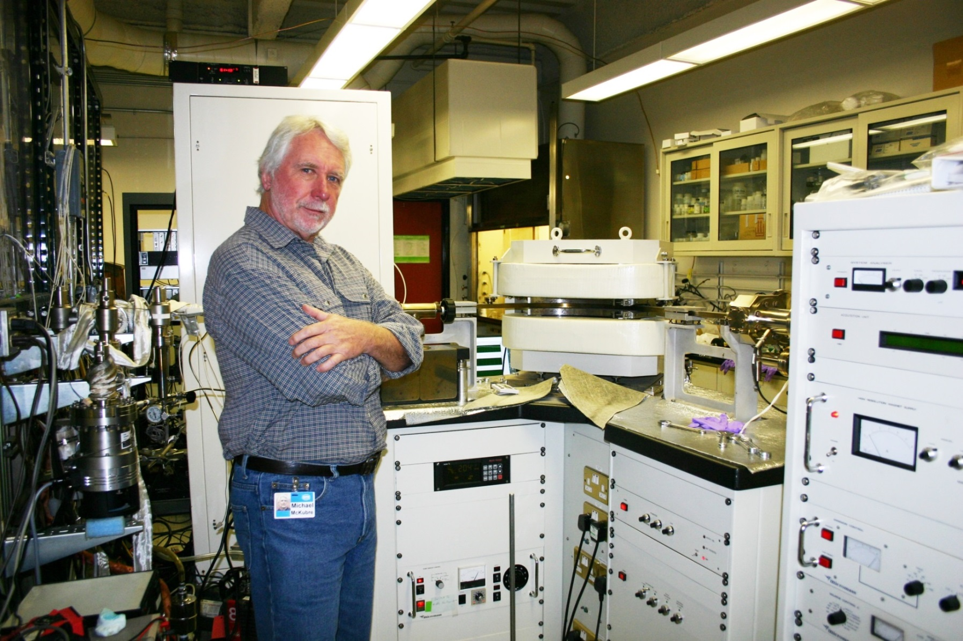
Dr. McKubre in his laboratory.
6th International Conference “Charged & Neutral Particles Channeling
Phenomena - Channeling 2014” (Capri, Italy, October 5-10, 2014)

Slide 16
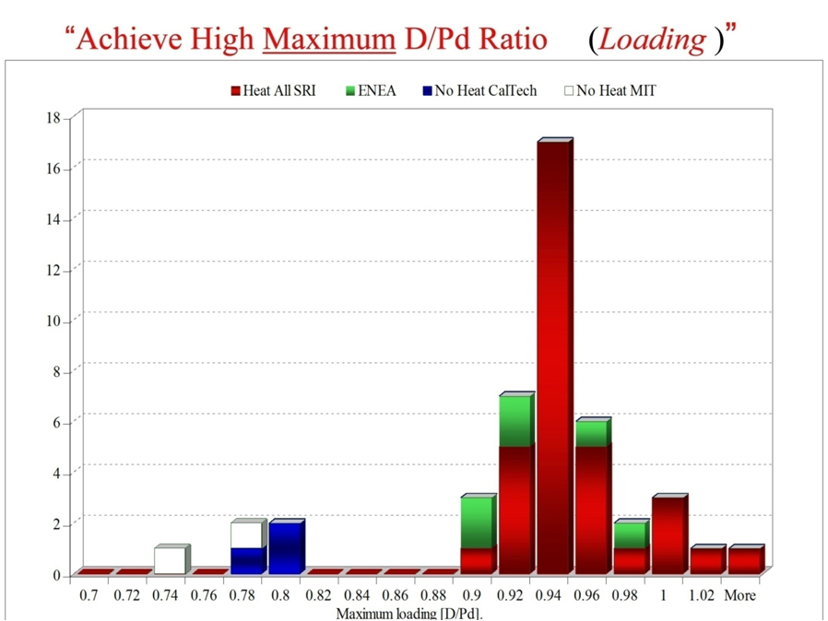
The success of the experiment depends on the concentration of deuterium.
Michael C.H. McKubre, Francis L. Tanzella, and Vittorio Violante, Journal of Condensed
Matter Nuclear Science, Volume 8, May 2012, p. 187
6th International Conference “Charged & Neutral Particles Channeling
Phenomena - Channeling 2014” (Capri, Italy, October 5-10, 2014)

Slide 17
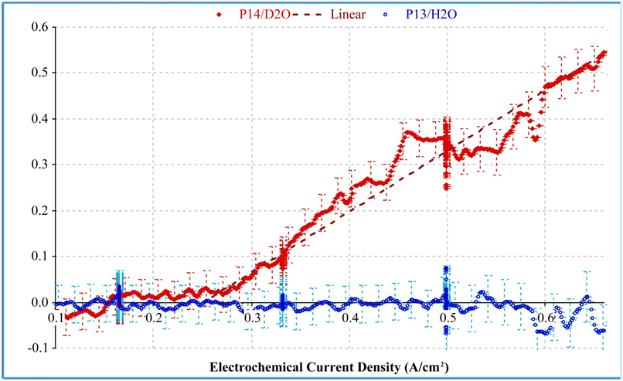
Excess heat in W, depending on the value of the
electrochemical current, in the experiments of Dr. McKubre
6th International Conference “Charged & Neutral Particles Channeling
Phenomena - Channeling 2014” (Capri, Italy, October 5-10, 2014)

Slide 18
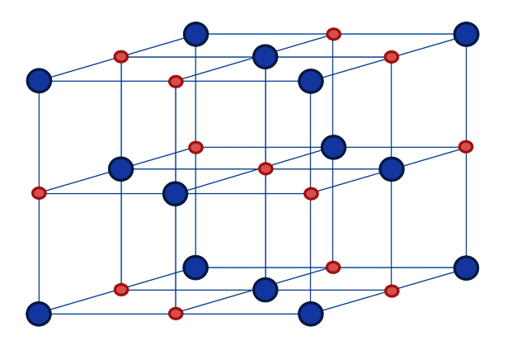
The fcc crystal structure. Small circles marked
octahedral (the deepest) niches.
6th International Conference “Charged & Neutral Particles Channeling
Phenomena - Channeling 2014” (Capri, Italy, October 5-10, 2014)

Slide 19
History of cold fusion “in vitro”
1. Martin Fleischmann 1989–2012
2. Michael McKubre 1992–today
3. Yoshiaki Arata 1998–2008
4. Hagelstein and Swartz (MIT) 1992–today
About 20–30 working groups in the US, Western Europe, Russia, Japan, and China.
During the last year, the first four patents were issued for cold fusion (US, Europe, China)
6th International Conference “Charged & Neutral Particles Channeling
Phenomena - Channeling 2014” (Capri, Italy, October 5-10, 2014)

Slide 20
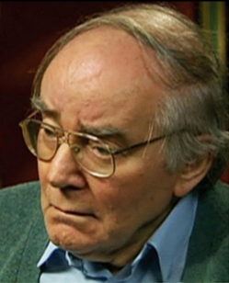
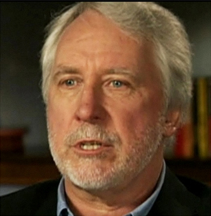
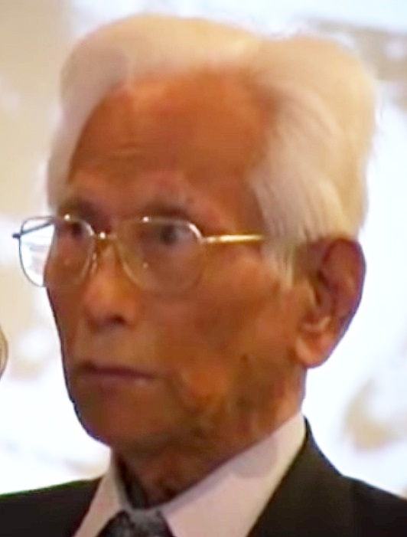
History of cold fusion – the main participants
Martin Fleischmann (1927–2012) D + D in palladium
1989
Michael McKubre
D + D in palladium
1992–present
Yoshiaki Arata
D + D a palladium (ZrO2)
1998–2008
Proof of concept of cold fusion suddenly came from experiments performed with accelerators.
6th International Conference “Charged & Neutral Particles Channeling
Phenomena - Channeling 2014” (Capri, Italy, October 5-10, 2014)

Slide 21
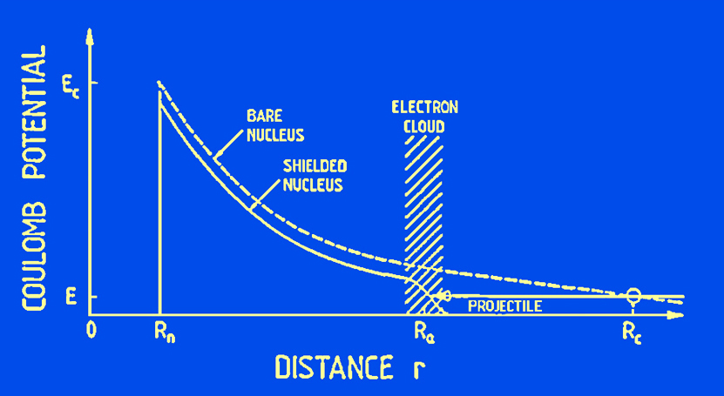
In the quantum-mechanical consideration of the fusion process, electron screening potential U_{e} is equivalent to the additional energy of particles involved (Assenbaum, Langanke, & Rolfs, 1987). “The penetration through a shielded Coulomb barrier at projectile energy E is equivalent to that of bare nuclei at energy E_{eff} = E + U_{e}.”
The figure, taken from an Assenbaum paper, schematically depicts a collision of an incident deuterium nucleus with a deuterium atom. For the collision of two free deuterium atoms, this additional energy is equal to 27 eV.
6th International Conference “Charged & Neutral Particles Channeling
Phenomena - Channeling 2014” (Capri, Italy, October 5-10, 2014)

Slide 22
It should be noted that during irradiation of solid state with a beam of charged particles, incident particle captures an electron from the solid body and moves like an atom, if its velocity does not exceed the so-called Bohr velocity.
For deuterons this threshold energy is ~ 50 keV.
This interesting observation was made in the paper:
Y.A. Baranov, Yu. Martynenko, S.O. Tsepelevich,
Yu.N. Yavlinsky, “Inelastic sputtering of solids by ions”, Physics-Uspekhi, November 1988, Volume 156, no. 3, p. 477.
6th International Conference “Charged & Neutral Particles Channeling
Phenomena - Channeling 2014” (Capri, Italy, October 5-10, 2014)

Slide 23
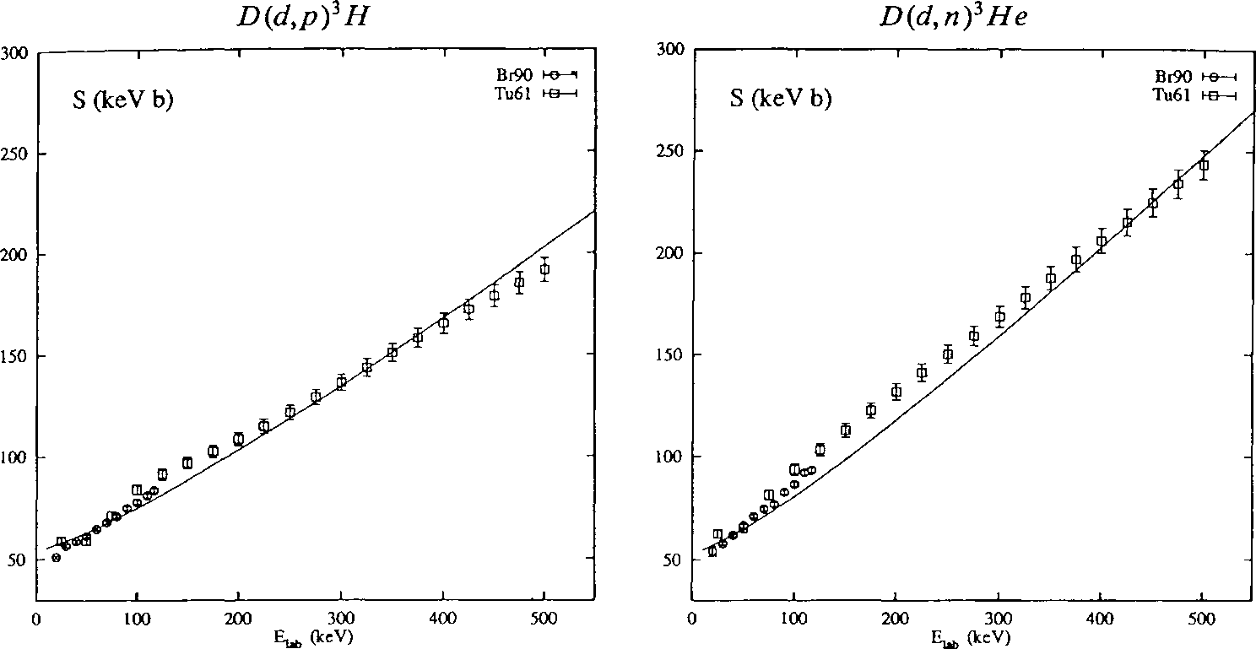
S(E) – astrophysical factor for reactions D(d,p)³H and D(d,n)³He,
Lemaitre, S. and Paetz gen. Schieck, H., Ann. Physik 2 (1993), 503.
6th International Conference “Charged & Neutral Particles Channeling
Phenomena - Channeling 2014” (Capri, Italy, October 5-10, 2014)

Slide 24
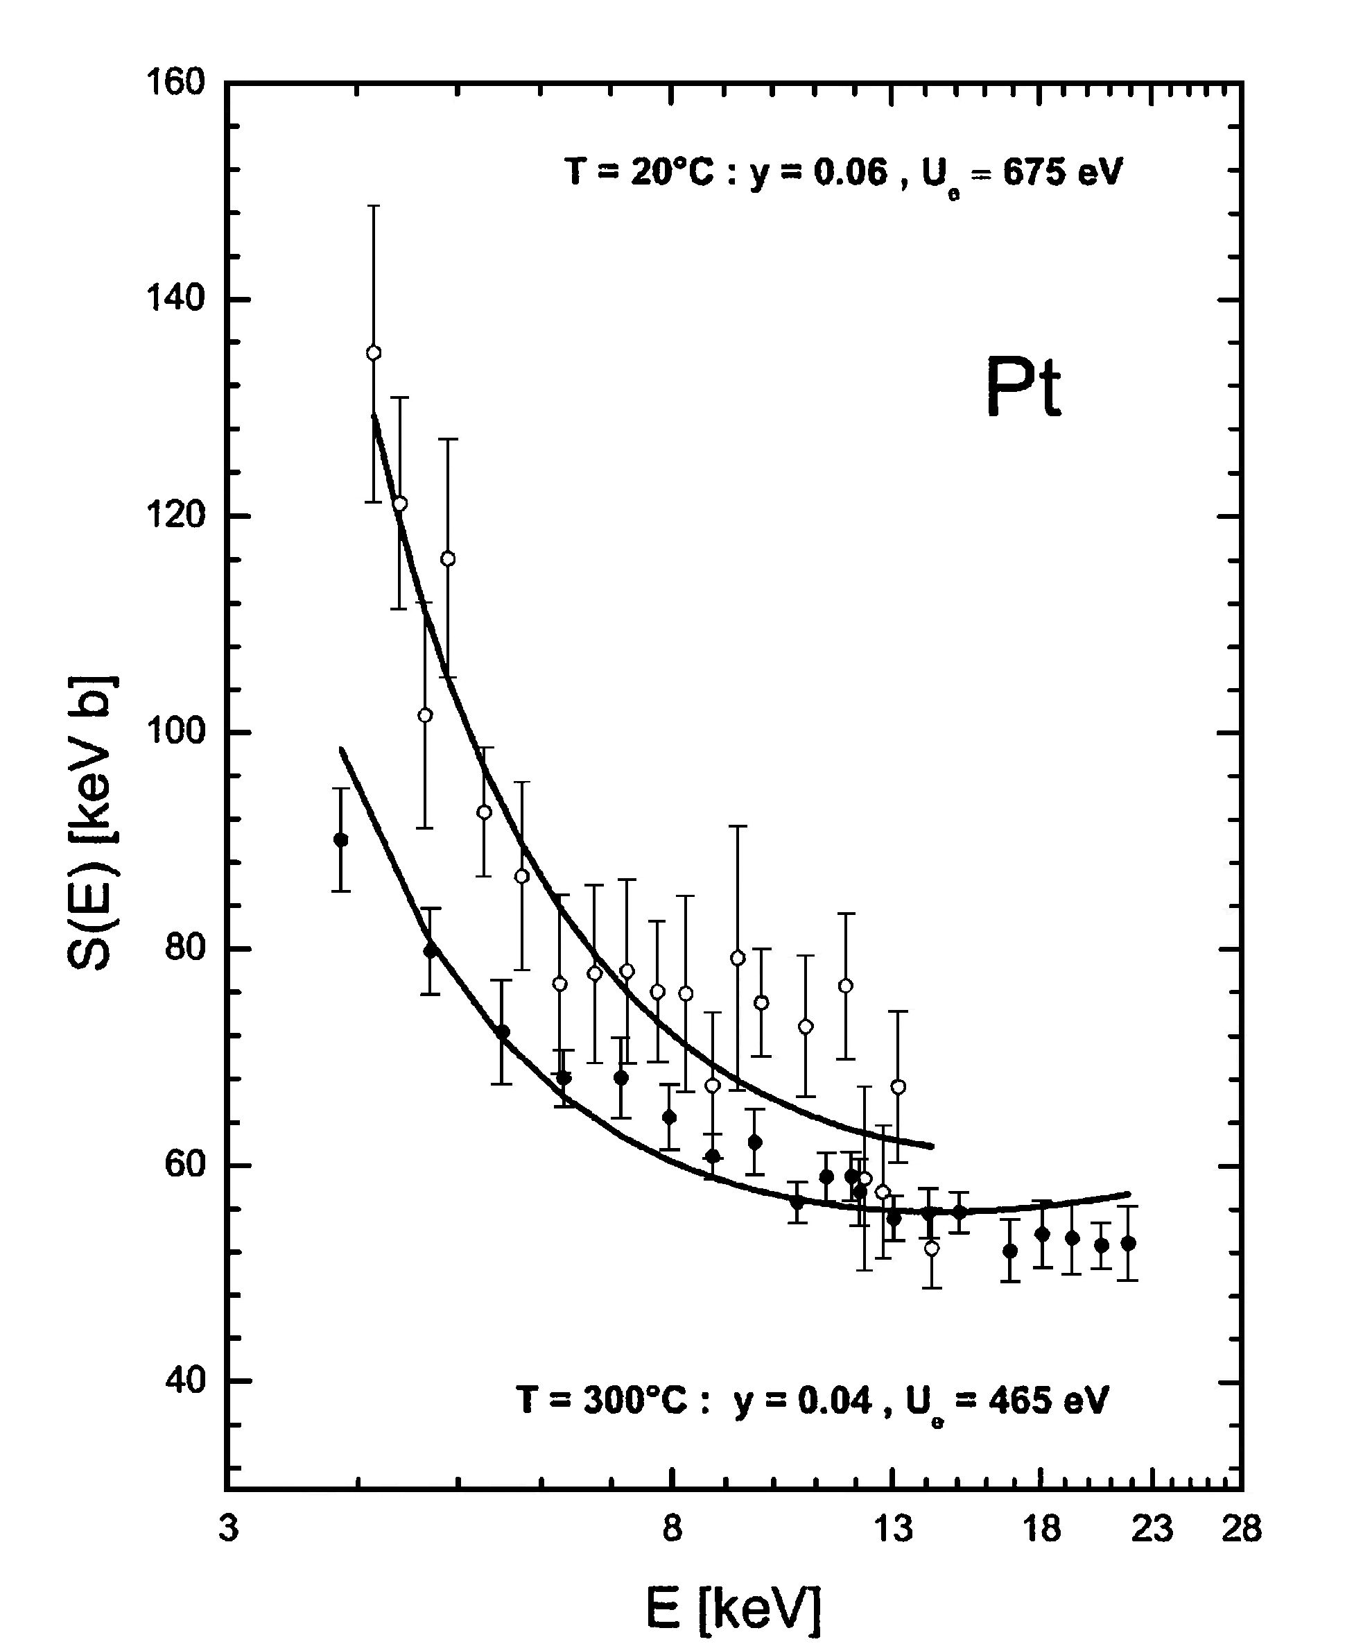
C. Rolfs et al., J. Phys. G: Nucl. Part. Phys. 31, 2005, pp 1141–1149. (Gran Sasso).
S(E) for DD-fusion, the target is implanted in Platinum, U_{e} = 675 eV.
6th International Conference “Charged & Neutral Particles Channeling
Phenomena - Channeling 2014” (Capri, Italy, October 5-10, 2014)

Slide 25
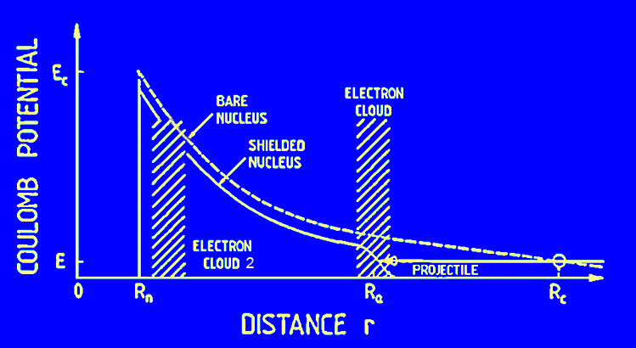
Screening potential defines the distance to which the atoms are not experiencing Coulomb repulsion.
300 эВ
27 эВ
6th International Conference “Charged & Neutral Particles Channeling
Phenomena - Channeling 2014” (Capri, Italy, October 5-10, 2014)

Slide 26
The accelerator experiments have shown that the magnitude of the screening potential of the impurity atoms in metallic crystals can reach 300 eV and even more. This means that in the DD-reaction occurring in the medium of the metal crystal, the implanted deuterium atoms are excited and no longer spherical. They have more sophisticated electronic orbitals, and they are oriented relative to each other in a certain crystallographic manner. In this case, the nuclei of these atoms can approach each other at the distance substantially less than for a nominal size of the atom without Coulomb repulsion.
Similar processes are known in chemistry and are the cause of chemical catalysis. Johannes Rydberg first described these processes in 1888.
6th International Conference “Charged & Neutral Particles Channeling
Phenomena - Channeling 2014” (Capri, Italy, October 5-10, 2014)

Slide 27
The main secret of cold fusion process—overcoming the Coulomb barrier—finally happened to be surprisingly simple. It was first noted by Prof. Bressani in 1998 at ICCF-7 conference on the basis of a series of Japanese accelerator experiments being performed since 1995.
Unfortunately, the cold fusion community at that time did not follow the call of Prof. Bressani.
6th International Conference “Charged & Neutral Particles Channeling
Phenomena - Channeling 2014” (Capri, Italy, October 5-10, 2014)

Slide 28
Target deuterium atoms implanted into metals are no longer in 1s-state. The free electron cloud in a metal causes the electron of an implanted atom to take up the excited p-state. The magnitude of the screening potential of 300 eV and above in experiments on DD-fusion accelerator experiments indicates that the incident deuterium atoms in the conducting crystal are also moving in p-state.
These processes allow the two deuterium nuclei to get close without the Coulomb repulsion in the potential niche of the crystal cell at a very close distance.
6th International Conference “Charged & Neutral Particles Channeling
Phenomena - Channeling 2014” (Capri, Italy, October 5-10, 2014)

Slide 29
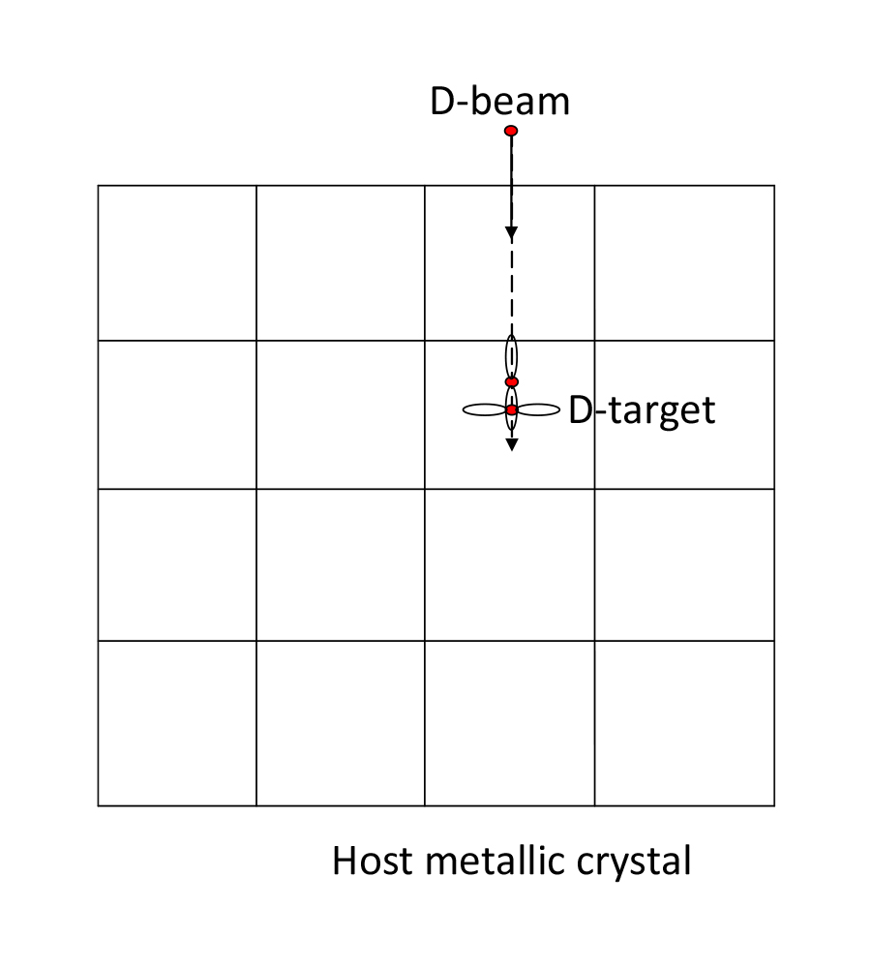
Accelerator experiments
6th International Conference “Charged & Neutral Particles Channeling
Phenomena - Channeling 2014” (Capri, Italy, October 5-10, 2014)

Slide 30
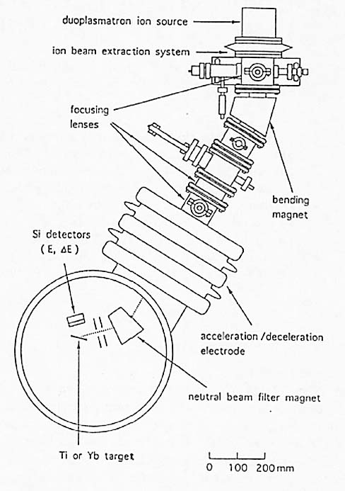
One of the first DD experiments on accelerators.
Yuki, H., Satoh, T., Ohtsuki, T., Yorita, T., Aoki, Y., Yamazaki, H., Kasagi, J. (1996).
ICCF-6, 13–18 October, Japan.
6th International Conference “Charged & Neutral Particles Channeling
Phenomena - Channeling 2014” (Capri, Italy, October 5-10, 2014)

Slide 31
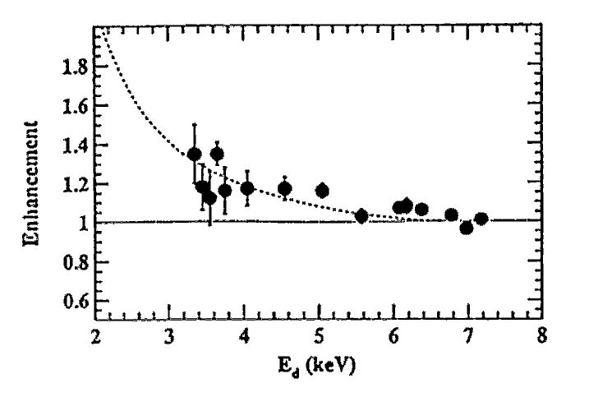
Yuki, H., Satoh, T., Ohtsuki, T., Yorita, T., Aoki, Y., Yamazaki, H.,
Kasagi, J. (1996). ICCF-6, 13–18 October, Japan.
This is one of the early works on electron screening in metals.
Ratio of the yield of the reaction D(d, p)T in the thick target to the
estimated yield value in ytterbium (Yb). The dashed line shows the
value of electron screening potential of 60 eV.
6th International Conference “Charged & Neutral Particles Channeling
Phenomena - Channeling 2014” (Capri, Italy, October 5-10, 2014)

Slide 32
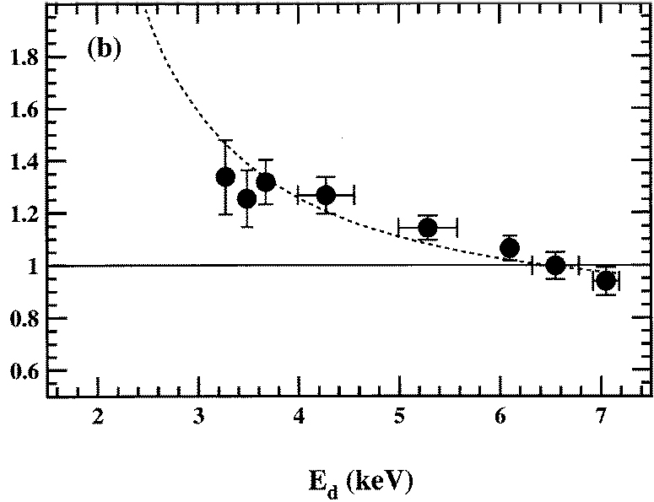
Yuki, H., Satoh, T., Ohtsuki, T., Yorita, T., Aoki, Y., Yamazaki, H., Kasagi, J. (1997). Phys. G: Nucl. Part. Phys., 23, 1,459–1,464. Increasing cross-section in ytterbium (rare earth element with a metallic conductivity)—electron screening potential reaches 81 ± 10 eV.
6th International Conference “Charged & Neutral Particles Channeling
Phenomena - Channeling 2014” (Capri, Italy, October 5-10, 2014)

Slide 33
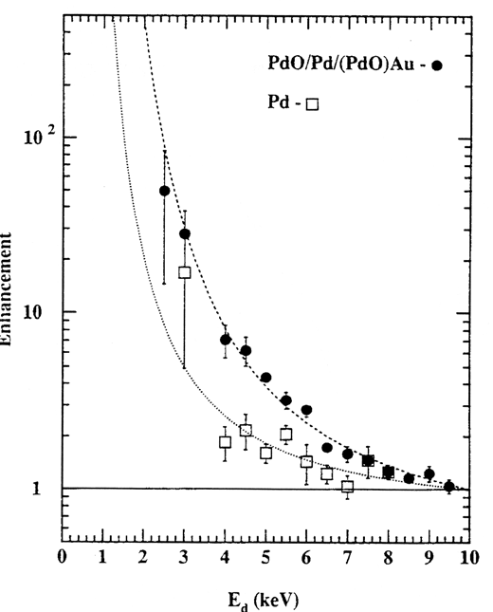
The Seventh International Conference on Cold Fusion. 1998. Vancouver, Canada:, ENECO, Inc., Salt Lake City, UT. p. 180.
“Anomalously enhanced d(d,p)t reaction in Pd and PdO observed at very low bombarding energies”
J. Kasagi, H. Yuki, T. Itoh, N. Kasajima, T. Ohtsuki and A. G. Lipson *
Laboratory of Nuclear Science, Tohoku University, Japan
* Institute of Physical Chemistry, The Russian Academy of Sciences, Moscow, Russia
The dotted and dashed curves are those with the screening potential U_{e} = 250 and 600 eV, respectively.
6th International Conference “Charged & Neutral Particles Channeling
Phenomena - Channeling 2014” (Capri, Italy, October 5-10, 2014)

Slide 34
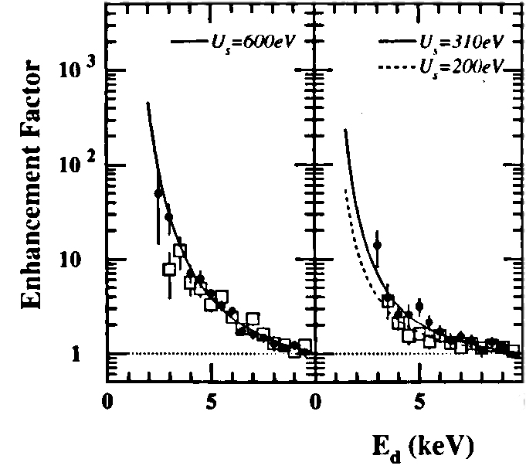
One of the latest (2002) Japanese DD accelerator experiments.
Jirohta Kasagi, Hideyuki Yuki, Taiji Baba, Takashi Noda, Tsutomu Ohtsuki and Andrey G. Lipson
“Strongly Enhanced DD Fusion Reaction in Metals Observed for keV D⁺ Bombardment”
Journal of the Physical Society of Japan, Vol. 71, No. 12, December, 2002, pp. 2881-2885.
PdO
Pd
Fe
6th International Conference “Charged & Neutral Particles Channeling
Phenomena - Channeling 2014” (Capri, Italy, October 5-10, 2014)

Slide 35
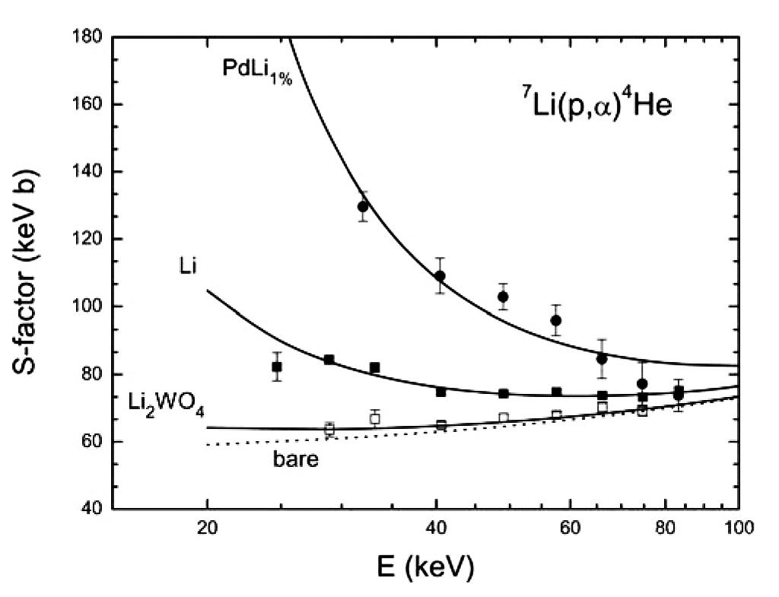
Rolfs, C. (2006). Nuclear Physics News, 16(2), 9. Normalized astrophysical factor S(E) for the synthesis of p+⁷Li when a target ⁷Li implanted into Palladium.
6th International Conference “Charged & Neutral Particles Channeling
Phenomena - Channeling 2014” (Capri, Italy, October 5-10, 2014)

Slide 36
Rolfs, C. et al. (2005). J. Phys. G: Nucl. Part. Phys., 31, 1,141–1,149. (Gran Sasso). S(E) for DD-fusion, targets are implanted in Platinum, U_{e} = 675 eV.
6th International Conference “Charged & Neutral Particles Channeling
Phenomena - Channeling 2014” (Capri, Italy, October 5-10, 2014)

Slide 37
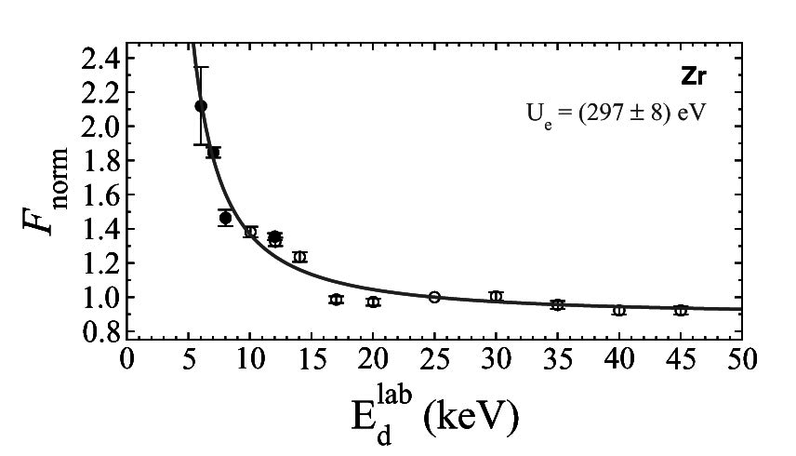
Czerski, K. et al., (2008). Physical Review C., 78, 015803, (Berlin). Normalized astrophysical factor S(E) for DD-fusion, when the target is implanted in zirconium. Screening potential is about 10 times greater than for the free atoms of deuterium.
6th International Conference “Charged & Neutral Particles Channeling
Phenomena - Channeling 2014” (Capri, Italy, October 5-10, 2014)

Slide 38
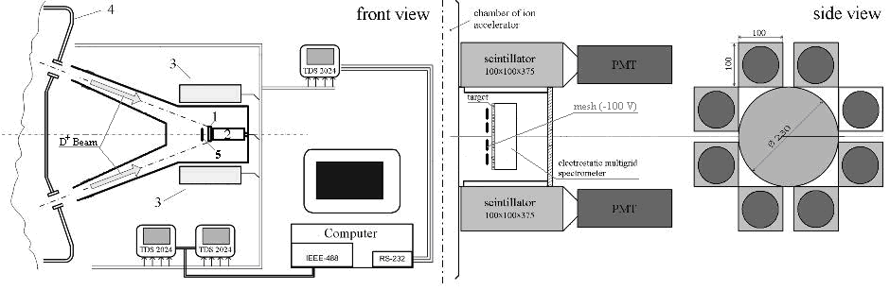
V. M. Bystritsky, Vit. M. Bystritskii, G. N. Dudkin, M. Filipowicz, S. Gazi, J. Huran, A. P. Kobzev, G. A. Mesyats, B. A. Nechaev, V. N. Padalko, S. S. Parzhitskii, F. M. Pen'kov, A. V. Philippov, V. L. Kaminskii, Yu. Zh. Tuleushev, J. Wozniak et al. (2012).
National Scientific Research—Tomsk Polytechnical University, Russia, Nuclear Physics, A 889, 93–104.
6th International Conference “Charged & Neutral Particles Channeling
Phenomena - Channeling 2014” (Capri, Italy, October 5-10, 2014)

Slide 39
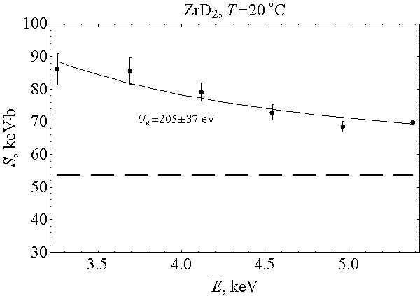
Bystritsky, V. M. et al., National Scientific Research—Tomsk Polytechnical University, Russia.
Nuclear Physics, A 889 (2012) 93–104.
6th International Conference “Charged & Neutral Particles Channeling
Phenomena - Channeling 2014” (Capri, Italy, October 5-10, 2014)

Slide 40
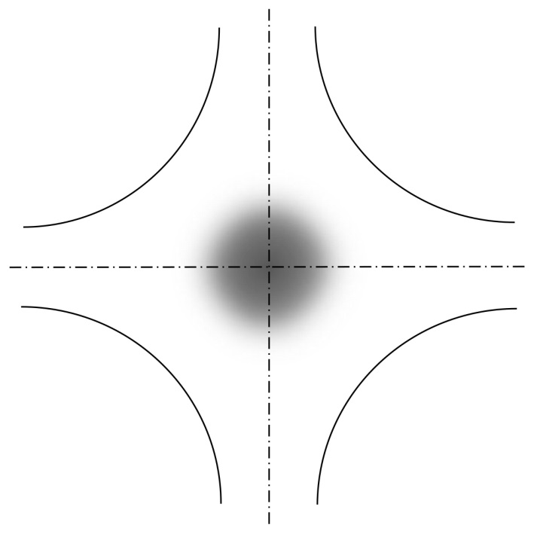
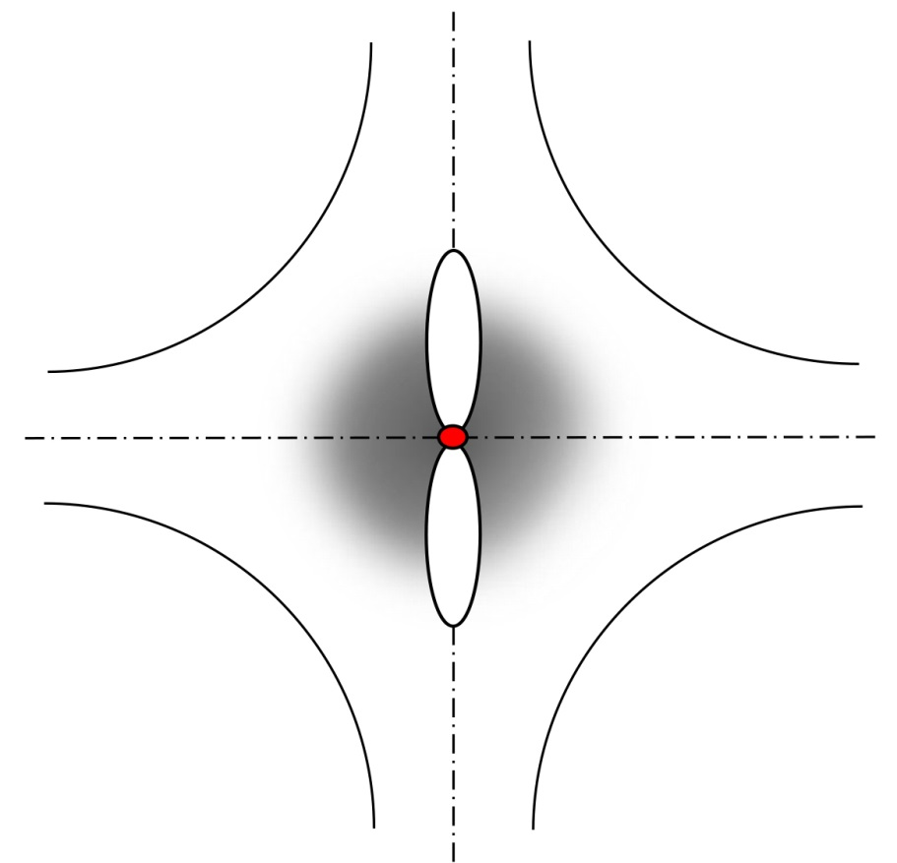
Crystal cell of conductor. The simple cubic structure is used as a didactic example. The shaded area shows the location of free electrons. Free electrons of conducting crystal are unwilling to vacate their positions completely, and the deuterium atom is transferred from 1s-state to 2p-state or higher.
6th International Conference “Charged & Neutral Particles Channeling
Phenomena - Channeling 2014” (Capri, Italy, October 5-10, 2014)

Slide 41
Thus, the convergence distance of two deuterium nuclei of impurity caught in the same crystalline niche of metal is at least an order of magnitude smaller than the size of the free atom of deuterium.
Although complete interpretation of this phenomenon is still lacking, many accelerator experiments leave no doubt for its existence. Coulomb barrier permeability in such conditions during the cold DD-fusion is very strongly increased as compared to the permeability of the barrier in the case of the free molecule of deuterium.
6th International Conference “Charged & Neutral Particles Channeling
Phenomena - Channeling 2014” (Capri, Italy, October 5-10, 2014)

Slide 42
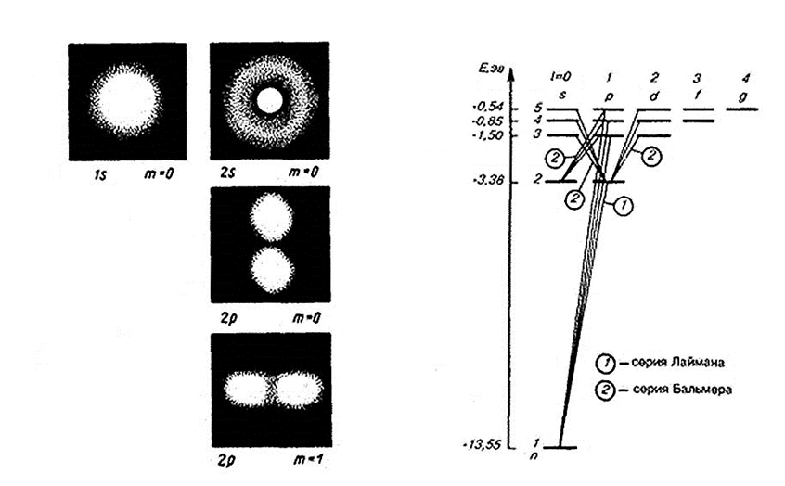
Rydberg mechanism for the hydrogen atom. Electron
orbital in 2p-state is no longer circular.
6th International Conference “Charged & Neutral Particles Channeling
Phenomena - Channeling 2014” (Capri, Italy, October 5-10, 2014)

Slide 43
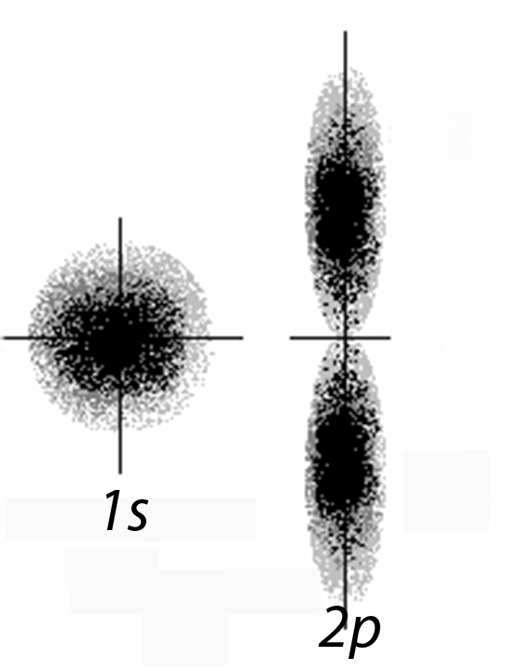
Orbitals of the hydrogen atom
6th International Conference “Charged & Neutral Particles Channeling
Phenomena - Channeling 2014” (Capri, Italy, October 5-10, 2014)

Slide 44
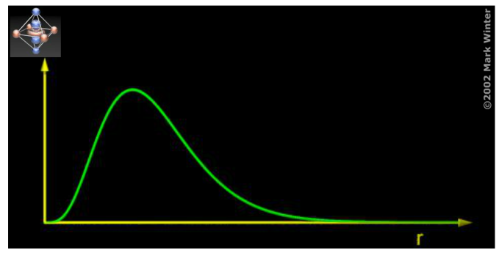
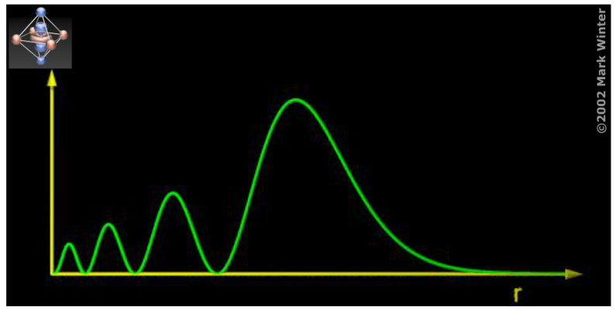
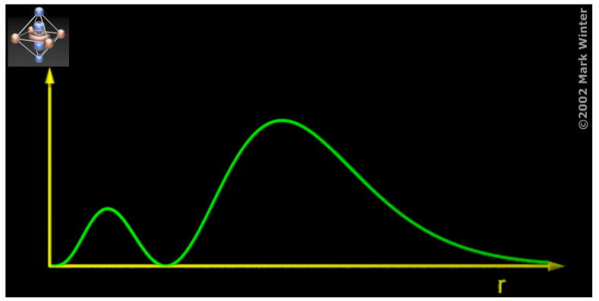
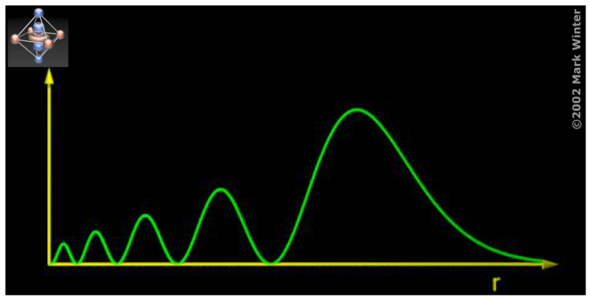
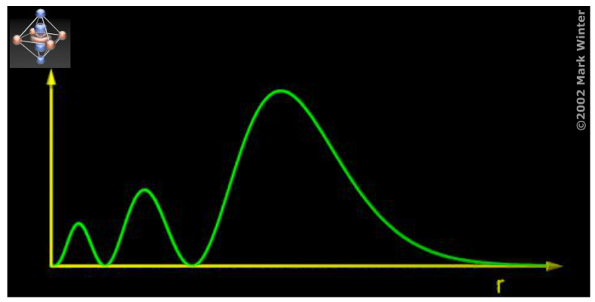
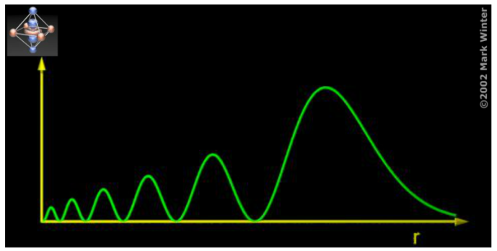
2p
5p
3p
6p
4p
7p
6th International Conference “Charged & Neutral Particles Channeling
Phenomena - Channeling 2014” (Capri, Italy, October 5-10, 2014)

Slide 45
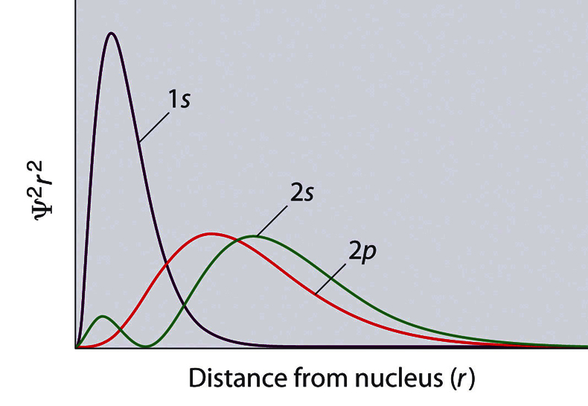
1s, 2s and 2p orbitals of hydrogen atoms
6th International Conference “Charged & Neutral Particles Channeling
Phenomena - Channeling 2014” (Capri, Italy, October 5-10, 2014)

Slide 46
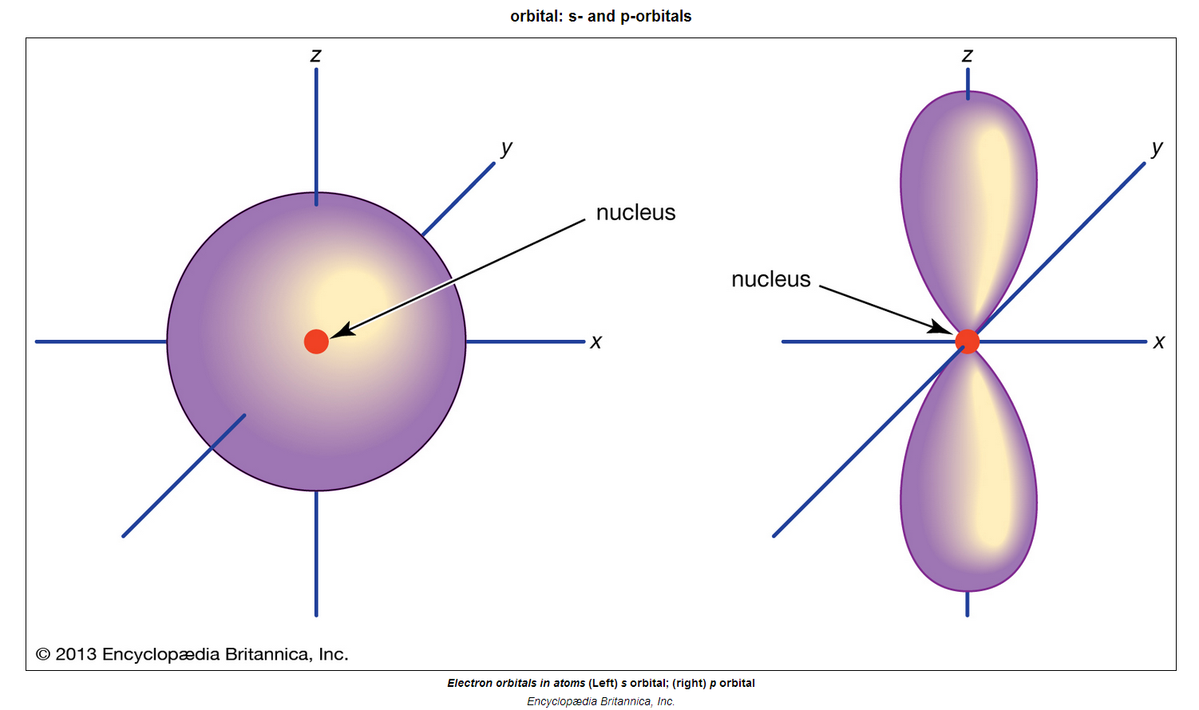
Orbitals of the hydrogen atom.
©2013 Encyclopædia Britannica, Inc.
1s
2p
6th International Conference “Charged & Neutral Particles Channeling
Phenomena - Channeling 2014” (Capri, Italy, October 5-10, 2014)

Slide 47
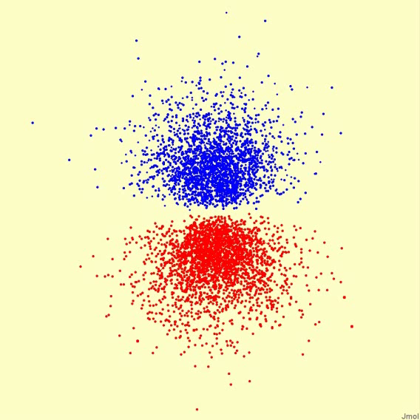
2p orbital of the hydrogen atom by Dr. Winter
6th International Conference “Charged & Neutral Particles Channeling
Phenomena - Channeling 2014” (Capri, Italy, October 5-10, 2014)

Slide 48
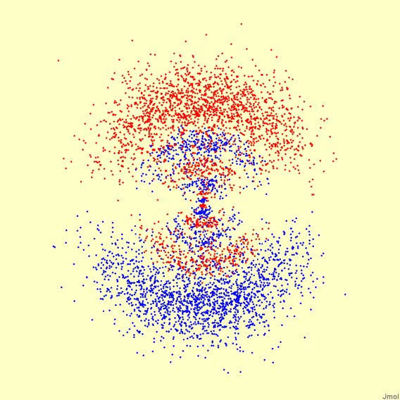
7p orbital of the hydrogen atom by Dr. Winter
6th International Conference “Charged & Neutral Particles Channeling
Phenomena - Channeling 2014” (Capri, Italy, October 5-10, 2014)

Slide 49
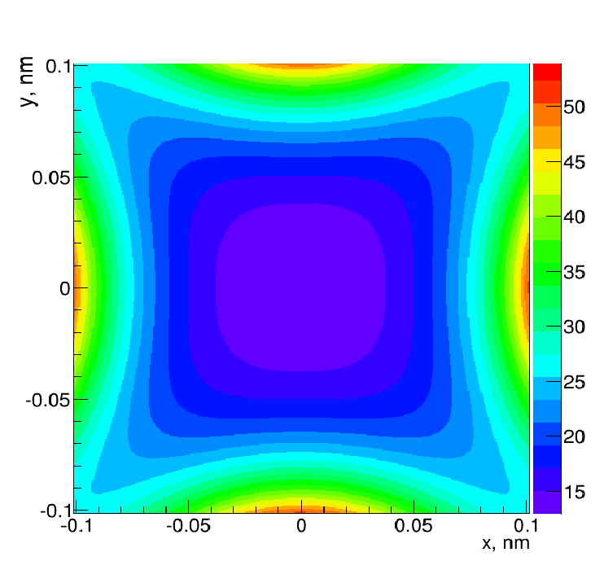
Structure of octahedral niche in platinum crystal.
Color scale is in Volts.
6th International Conference “Charged & Neutral Particles Channeling
Phenomena - Channeling 2014” (Capri, Italy, October 5-10, 2014)

Slide 50
Octahedral platinum crystal niche filled with a
deuterium atom in 2p-state
6th International Conference “Charged & Neutral Particles Channeling
Phenomena - Channeling 2014” (Capri, Italy, October 5-10, 2014)

Slide 51
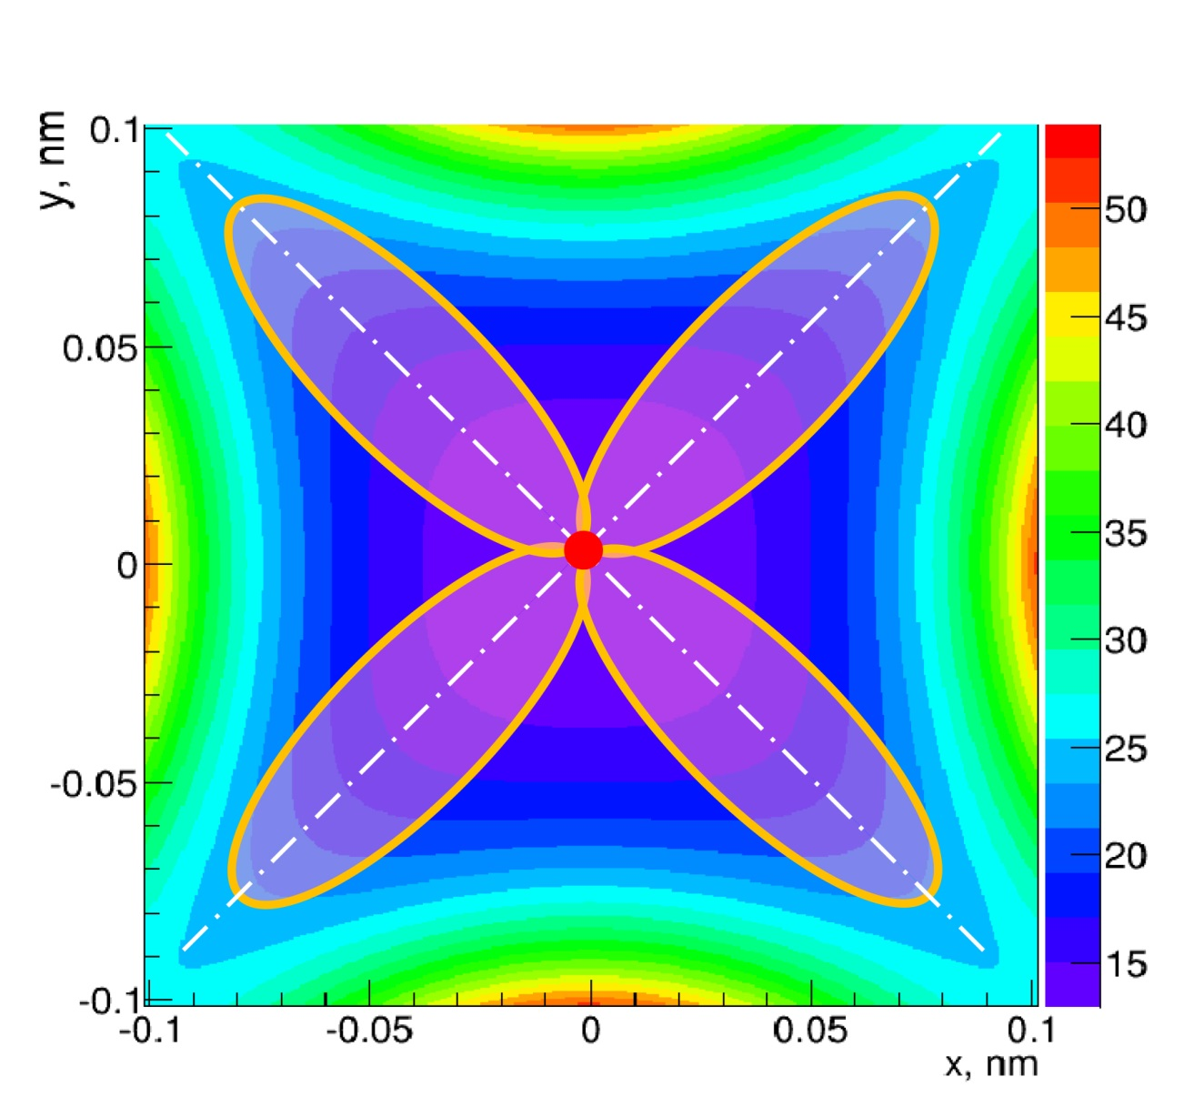
Octahedral platinum crystal niche filled with two
deuterium atoms in 2p-state
6th International Conference “Charged & Neutral Particles Channeling
Phenomena - Channeling 2014” (Capri, Italy, October 5-10, 2014)

Slide 52
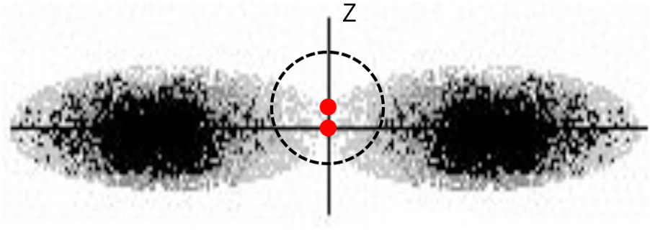

The case when two atoms of deuterium in 2p-state are located in the same octahedral niche of conducting fcc crystal.
The situation is quite similar to the process of μ−catalysis
6th International Conference “Charged & Neutral Particles Channeling
Phenomena - Channeling 2014” (Capri, Italy, October 5-10, 2014)

Slide 53
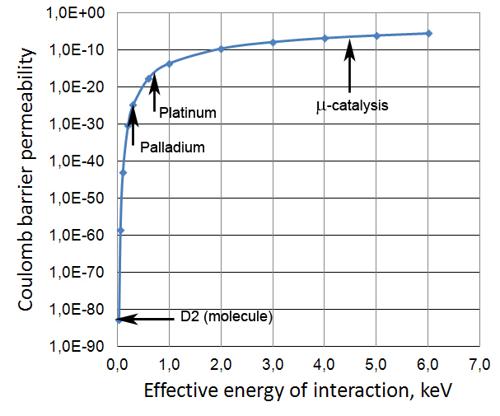
Coulomb barrier permeability for DD fusion:
P = e^{−2πη} (2πη = 31.41/E_{eff}^{1/2}, E_{eff} = E + U_{e})
For cold fusion,
E ≅ 0.040 eV
Pt/D2 ≅ 10⁶⁵
6th International Conference “Charged & Neutral Particles Channeling
Phenomena - Channeling 2014” (Capri, Italy, October 5-10, 2014)

Slide 54
So, the first secret of cold fusion which necessarily results in the fusion of deuterium nuclei deuterium saturation in conducting crystal today can be considered practically solved.
The second surprise of the cold fusion process: in these reactions there are practically no standard nuclear decay products of ⁴He*.
6th International Conference “Charged & Neutral Particles Channeling
Phenomena - Channeling 2014” (Capri, Italy, October 5-10, 2014)

Slide 55
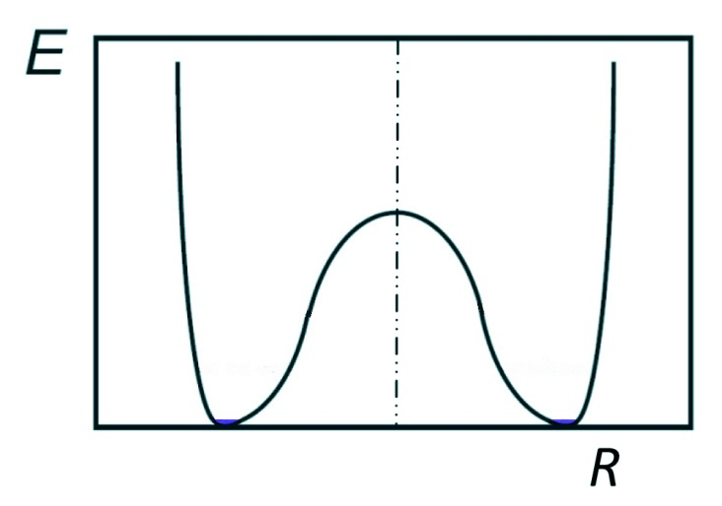
A possible cause of slowing of nuclear decay rate with decreasing of the excitation energy: a residual Coulomb barrier between the deuterium nuclei that already in the potential well of the strong interactions.
6th International Conference “Charged & Neutral Particles Channeling
Phenomena - Channeling 2014” (Capri, Italy, October 5-10, 2014)

Slide 56
11/22/2012
Дорогой Эдуард Николаевич!
Я никогда не отрицал возможности того, что при электролизе могут происходить очень редкие реакции синтеза dd за счёт, например, ускорения дейтонов до энергий несколько кэВ в образующихся в кристалле щелях, на границе которых накапливаются заряды различного знака. Идея каналирования может повысить эту вероятность, подобно тому, как повышается светимость коллайдеров за счёт сжатия встречных пучков. Однако Ваше объяснение отсутствия наблюдаемых нейтронов от реакции
dd →₃He +n совершенно неприемлемо. Уровни энергии ядра гелия 4 хорошо известны и от 1-го возбуждённого уровня (~ 20 МэВ) нет промежуточных уровней. Поэтому нет возможности передачи энергии решётке через γ-кванты.
Тем не менее, относясь серьёзно к Вашим наблюдениям, хотел бы высказать Вам одну гипотезу: реакции dd→₃He+n и dd→t+p идут при энергиях несколько кэВ с одинаковой вероятностью. Однако внутри кристаллического канала положительно заряженная частица обладает большой потенциальной энергией. Поэтому реакция с образованием ₃Не при переходе протона из одного ядра дейтерия к другому может иметь дополнительный порог и будет подавлена. Таким образом, синтез будет происходить с образованием протона и ядра трития. А убедиться на опыте, что получается выход трития , значительно сложнее, чем выход нейтронов.
Я не интересовался и не знаю последних данных: наблюдали или нет выход трития в экспериментах по холодному синтезу?
Вы сами можете это оценить.
С приветом, С Герштейн
6th International Conference “Charged & Neutral Particles Channeling
Phenomena - Channeling 2014” (Capri, Italy, October 5-10, 2014)

Slide 57
One can assume that the potential inside of the Coulomb barrier well after the strong interactions of the fusion reaction is no longer a retaining factor for neutrons, and neutrons can almost freely move from one proton to another. In this case, the metastable DD-system goes into a metastable PT-system. However, that “almost free” needs the additional energy of about 2 MeV, due to the binding energy of the deuteron. Let us recall that in our case the energy of the deuterons in the well of strong interactions is very small, much less than 1 eV.
Also, “Statistical principle of correlation weakening with distance” (N. N. Bogolubov, Selected works on statistical physics, M., 1979) may be working for neutrons.
6th International Conference “Charged & Neutral Particles Channeling
Phenomena - Channeling 2014” (Capri, Italy, October 5-10, 2014)

Slide 58
According to our hypothesis, the rate of nuclear decay of a compound nucleus ⁴He* is a function of the excitation energy of the nucleus E_{k}. We assume that when the
E_{k} ~ 0 (thermal energy), the compound nucleus ⁴He* is metastable with a lifetime of about 10⁻¹⁵ s. After a time of ~10⁻¹⁶ seconds, the compound nucleus is no longer an isolated system, since virtual photons γ∗ from the ⁴He* can reach the nearest electrons in a crystal, and carry away the excitation energy of the compound nucleus ⁴He*. It must be emphasized that the above hypothesis is merely an attempt to explain the well-established experimental fact of the virtual absence of nuclear decay channels of the intermediate compound nucleus ⁴He* in the process of cold fusion.
6th International Conference “Charged & Neutral Particles Channeling
Phenomena - Channeling 2014” (Capri, Italy, October 5-10, 2014)

Slide 59
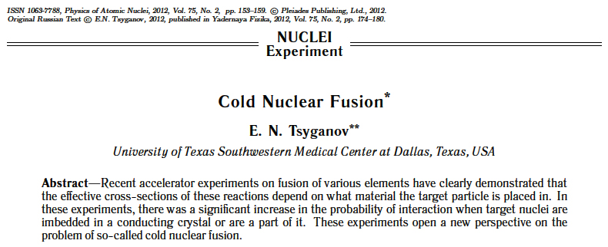
First publication
6th International Conference “Charged & Neutral Particles Channeling
Phenomena - Channeling 2014” (Capri, Italy, October 5-10, 2014)

Slide 60
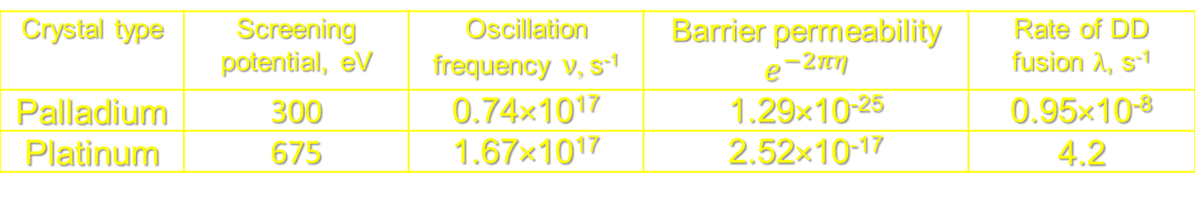
Rate of DD-fusion in the crystalline cell
Crystal type | Screening potential, eV | Oscillation frequency $ν$, s⁻¹ | Barrier permeability $e^{−2πη}$ | Rate of DD fusion $λ$, s⁻¹
Palladium | 300 | 0.74×10¹⁷ | 1.29×10⁻²⁵ | 0.95×10⁻⁸
Platinum | 675 | 1.67×10¹⁷ | 2.52×10⁻¹⁷ | 4.2
E.N. Tsyganov, Physics of Atomic Nuclei, 2012, Vol. 75, No. 2, pp. 153–159.
Э.Н. Цыганов, ЯДЕРНАЯ ФИЗИКА, 2012, том 75, № 2, с. 174–180.
6th International Conference “Charged & Neutral Particles Channeling
Phenomena - Channeling 2014” (Capri, Italy, October 5-10, 2014)

Slide 61
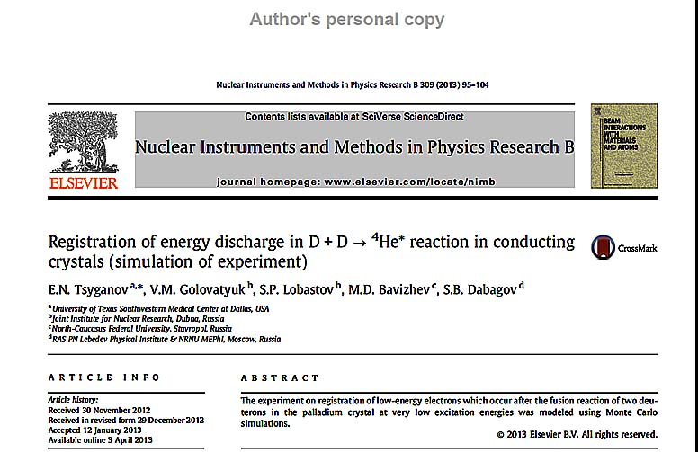
In our recent articles, we discuss the possibility of experimental detection of the “cold” DD-fusion process using low-energy electrons, which are the result of the fusion reaction of two deuterons in palladium crystals at very low (thermal) excitation energies of the compound nucleus ⁴He*.
6th International Conference “Charged & Neutral Particles Channeling
Phenomena - Channeling 2014” (Capri, Italy, October 5-10, 2014)

Slide 62
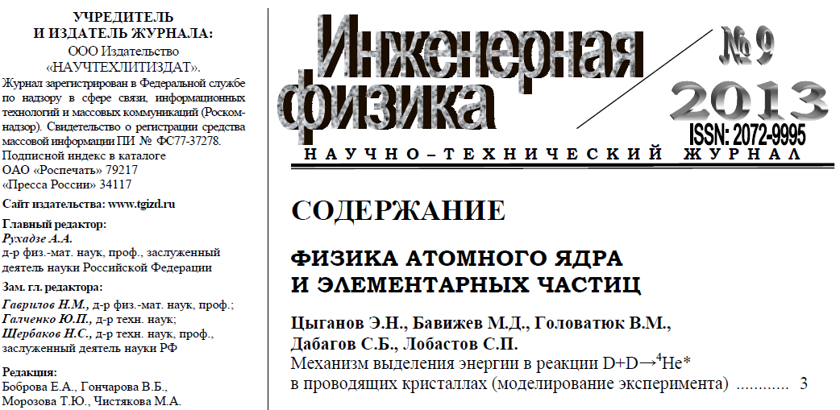
Engineering Physics, 2013
6th International Conference “Charged & Neutral Particles Channeling
Phenomena - Channeling 2014” (Capri, Italy, October 5-10, 2014)

Slide 63

Engineering Physics, 2014
6th International Conference “Charged & Neutral Particles Channeling
Phenomena - Channeling 2014” (Capri, Italy, October 5-10, 2014)

Slide 64

Engineering Physics, June 2014
6th International Conference “Charged & Neutral Particles Channeling
Phenomena - Channeling 2014” (Capri, Italy, October 5-10, 2014)

Slide 65
Atomic potentials of the cluster of 5×5×5 cells in the platinum crystal
6th International Conference “Charged & Neutral Particles Channeling
Phenomena - Channeling 2014” (Capri, Italy, October 5-10, 2014)

Slide 66

Diagonal X-V plane of fcc crystals. Signs O marks octahedral vacancies; signs T − tetrahedral ones.
6th International Conference “Charged & Neutral Particles Channeling
Phenomena - Channeling 2014” (Capri, Italy, October 5-10, 2014)

Slide 67

Potential contours in the diagonal X-V plane for Platinum.
6th International Conference “Charged & Neutral Particles Channeling
Phenomena - Channeling 2014” (Capri, Italy, October 5-10, 2014)

Slide 68

Potential in the vicinity of the center of octahedral niche of platinum crystal cell along the V-direction.
6th International Conference “Charged & Neutral Particles Channeling
Phenomena - Channeling 2014” (Capri, Italy, October 5-10, 2014)

Slide 69

Virtual photons in the hydrogen atom
(Richard Feynman)
6th International Conference “Charged & Neutral Particles Channeling
Phenomena - Channeling 2014” (Capri, Italy, October 5-10, 2014)

Slide 70

Virtual photons from ⁴He*, Feynman's
representation (guess)
6th International Conference “Charged & Neutral Particles Channeling
Phenomena - Channeling 2014” (Capri, Italy, October 5-10, 2014)

Slide 71

Diagram of “thermalization” process of ⁴He* with multiple virtual photon exchanges. In order for this process to work, the existence of a metastable state of ⁴He* is necessary.
6th International Conference “Charged & Neutral Particles Channeling
Phenomena - Channeling 2014” (Capri, Italy, October 5-10, 2014)

Slide 72

The trajectories of electrons (Monte Carlo) generated in the process of DD cold fusion in palladium. Dimensions are in micrometers.
6th International Conference “Charged & Neutral Particles Channeling
Phenomena - Channeling 2014” (Capri, Italy, October 5-10, 2014)

Slide 73

One-side scheme of the experiment. Several silicon detectors are placed on the same side of the palladium foil and included in coincidence. Left — side view, right — the relative positions of the aperture and detectors.
6th International Conference “Charged & Neutral Particles Channeling
Phenomena - Channeling 2014” (Capri, Italy, October 5-10, 2014)

Slide 74

Energy emitted by 60 keV electrons in detectors placed on one side of the palladium foil. The spectrum extends up to 14 MeV, because some of the electrons are scattered in palladium at angles up to 180 degrees.
6th International Conference “Charged & Neutral Particles Channeling
Phenomena - Channeling 2014” (Capri, Italy, October 5-10, 2014)

Slide 75
Experiments of DD-fusion in metals on accelerators
H Yuki, T Satoh, T Ohtsuki, T Yorita, Y Aoki, H Yamazaki and J Kasagi “D+D reaction in metal at bombarding energies below 5 keV”в журнале J. Phys. G: Nucl. Part. Phys. 23 (1997) 1459–1464.
J. Kasagi, H. Yuki, T. Itoh, N. Kasajima, T. Ohtsuki and A. G. Lipson* “Anomalously enhanced d(d,p)t reaction in Pd and PdO observed at very low bombarding energies”, the Seventh International Conference on Cold Fusion, 1998. Vancouver, Canada:, ENECO, Inc., Salt Lake City, UT : p. 180.
H. Yuki, J. Kasagi, A.G. Lipson, T. Ohtsuki, T. Baba, T. Noda, B.F. Lyakhov, N. Asami “Anomalous Enhancement of DD Reaction in Pd and Au/Pd/PdO heterostructure targets under a low energy deuteron bombardment”, письма в ЖЭТФ, том 68, выпуск 11, 10 декабря,1998.
J. Kasagi, H. Yuki, T. Baba and T. Noda “Low Energy Nuclear Fusion Reactions in Solids”, 8th International Conference on Cold Fusion.,2000. Lerici (La Spezia), Italy: Italian Physical Society, Bologna, Italy.
A.G. Lipson, G.H. Miley, A.S. Roussetski, A.B. Karabut “strong enhancement of dd-reaction…” ICCF-10, 2003 г.
Claus Rolfs – Gran Sasso, 2002 – 2006
  C. Rolfs, “Enhanced electron screening in metals: a plasma of the poor man”, Nucl. Phys. News 16 (2) (2006).
  F. Raiola, (for the LUNA Collaboration), B. Burchard, Z. Fulop, et al., J. Phys. G: Nucl. Part. Phys. 31 (2005) 1141;
  F. Raiola, (for the LUNA Collaboration), B. Burchard, Z. Fulop, et al., Eur. Phys. J. A27 (2006) 79.
K. Czerski – Berlin, 2002 – 2009
  A. Huke, K. Czerski, P. Heide, G. Ruprecht, N. Targosz, W. Zebrowski, Phys. Rev. C 78 (2008) 015803.
  K. Czerski, A. Huke, P. Heide, et al., J. Phys. G 35, 014012 (2008).
Tomsk Collaboration, 2012 - 2013
V. M. Bystritsky et al, National Scientific Research - Tomsk Polytechnical University, Russia, Physics of Atomic Nuclei, 2012, Vol. 75,
No. 1, pp. 53–62.
V. M. Bystritsky et al, National Scientific Research - Tomsk Polytechnical University, Russia, Nuclear Physics, 2013 (in press)
6th International Conference “Charged & Neutral Particles Channeling
Phenomena - Channeling 2014” (Capri, Italy, October 5-10, 2014)

Slide 76
Conclusion - 1
1. Existence of the phenomenon of cold fusion now is conclusively proven by the experiments, including experiments on low-energy accelerators.
2. The absence of nuclear products observed in cold fusion experiments can be explained by slowing down the decay speed of a compound nucleus ⁴He* via nuclear channels with decreasing energy of its excitation. Energy release is due to virtual photons.
3. Prejudice of many nuclear physicists toward the cold fusion phenomenon is associated with this unusual nuclear process. In the cold fusion process, the resulting intermediate compound nucleus ⁴He* is in a metastable state.
6th International Conference “Charged & Neutral Particles Channeling
Phenomena - Channeling 2014” (Capri, Italy, October 5-10, 2014)

Slide 77
Conclusion - 2
4. The accumulated empirical rules of nuclear physics are considered by the nuclear physics community as indisputable, while the range of application of these rules is limited.
5. Cold fusion provides sufficiently more practical opportunities than the expected traditional thermonuclear fusion.
Some of the applications of cold fusion (ships, aircraft, and space travel) are simply unavailable for devices of cyclopean scale—tokamaks and other hypothetical facilities using thermonuclear fusion.
6th International Conference “Charged & Neutral Particles Channeling
Phenomena - Channeling 2014” (Capri, Italy, October 5-10, 2014)

Slide 78

LPHE, November 15, 2012
6th International Conference “Charged & Neutral Particles Channeling
Phenomena - Channeling 2014” (Capri, Italy, October 5-10, 2014)

Slide 79

LPHE, November 15, 2012
6th International Conference “Charged & Neutral Particles Channeling
Phenomena - Channeling 2014” (Capri, Italy, October 5-10, 2014)

Slide 80

RASA, 8-10 November 2013, Clearwater Beach, FL
6th International Conference “Charged & Neutral Particles Channeling
Phenomena - Channeling 2014” (Capri, Italy, October 5-10, 2014)

Slide 81


RASA, 8-10 November 2013, Clearwater Beach, FL
6th International Conference “Charged & Neutral Particles Channeling
Phenomena - Channeling 2014” (Capri, Italy, October 5-10, 2014)

Slide 82

RASA, 8-10 November 2013, Clearwater Beach, FL
6th International Conference “Charged & Neutral Particles Channeling
Phenomena - Channeling 2014” (Capri, Italy, October 5-10, 2014)

Slide 83
Recently (July 7, 2014) the talk on cold fusion process was presented in Bogolyubov Theoretical Physics Laboratory, JINR, Dubna. My report “DD fusion in conducting crystals” has caused a fruitful debate.
Additional information:
http://science-tv.jinr.ru/?p=2442#more-2442
https://www.youtube.com/watch?v=oVREaeowqJ8&list=PLHorZmSbM-E4Xydx6Z6xmYPDur5ZBLCvj
http://www.coldfusion-power.com/dubna-jinr.html
http://coldfusionnow.org/joint-institute-of-nuclear-research-cold-fusion-seminar-video
6th International Conference “Charged & Neutral Particles Channeling
Phenomena - Channeling 2014” (Capri, Italy, October 5-10, 2014)

Slide 84




Joint Institute for Nuclear Research, Bogolyubov Laboratory of Theoretical Physics, Dubna, July 7, 2014
6th International Conference “Charged & Neutral Particles Channeling
Phenomena - Channeling 2014” (Capri, Italy, October 5-10, 2014)

Slide 85
ITER Project
Tokamaks were invented in the 1950s by Soviet physicists
Igor Tamm and Andrei Sakharov, inspired by an original
idea of Oleg Lavrentiev.
ITER: ²D + ³T → ⁴He + n + 17.6 MeV
Predicted: Start of deuterium-tritium operation
on 2027.
6th International Conference “Charged & Neutral Particles Channeling
Phenomena - Channeling 2014” (Capri, Italy, October 5-10, 2014)

Slide 86

Joint European Torus, UK
6th International Conference “Charged & Neutral Particles Channeling
Phenomena - Channeling 2014” (Capri, Italy, October 5-10, 2014)

Slide 87

ITER, May 2014
6th International Conference “Charged & Neutral Particles Channeling
Phenomena - Channeling 2014” (Capri, Italy, October 5-10, 2014)

Slide 88
ITER, May 2014
6th International Conference “Charged & Neutral Particles Channeling
Phenomena - Channeling 2014” (Capri, Italy, October 5-10, 2014)

Slide 89

ITER, August 2014
6th International Conference “Charged & Neutral Particles Channeling
Phenomena - Channeling 2014” (Capri, Italy, October 5-10, 2014)

Slide 90

ITER, August 2014
6th International Conference “Charged & Neutral Particles Channeling
Phenomena - Channeling 2014” (Capri, Italy, October 5-10, 2014)

Slide 91

ITER, September 2014
6th International Conference “Charged & Neutral Particles Channeling
Phenomena - Channeling 2014” (Capri, Italy, October 5-10, 2014)

Slide 92

ITER, September 2014
6th International Conference “Charged & Neutral Particles Channeling
Phenomena - Channeling 2014” (Capri, Italy, October 5-10, 2014)

Slide 93

ITER project
6th International Conference “Charged & Neutral Particles Channeling
Phenomena - Channeling 2014” (Capri, Italy, October 5-10, 2014)

Slide 94

ITER project
According to E.P. Velikhov estimations, ITER project could be ready to 2050
6th International Conference “Charged & Neutral Particles Channeling
Phenomena - Channeling 2014” (Capri, Italy, October 5-10, 2014)

Slide 95
Thank you for your attention!
6th International Conference “Charged & Neutral Particles Channeling
Phenomena - Channeling 2014” (Capri, Italy, October 5-10, 2014)

